Slide 1

R&D IT Platforms
Enterprise Architecture
Solution Delivery
D&A
Company Restricted

Slide 2
R&D IT Platforms Teams – September 2024 View
Target Discovery
Drug Discovery
3
2
Pre-Clinical
Science
Clinical Trials
(Ph 1-3)
Submission & Approval
Delivery & Monitoring
1
4
5
6
Traditional Delivery
R&D Portfolio & Capacity Management
Human Biosamples
ELN / LIMS
Case Management (Oracle Argus)
R&D IT Product Delivery
Digital Lab
Operational Clinical Development
ERV + VQV
Augmented DMTA
Invivo
Digital Patient Solutions (DPS)
Biologics Discovery
Study Design & Intelligence
Momentum (NGS)
APD/CMC
BIKG
Drug Development Data Platform (3DP)
Omics
Imaging
Scientific Compute Platform
Enterprise Product Delivery
Enterprise AI Platforms (AI Ops, Competitive Intelligence, NLP, Information Engineering & External Content)
Data Foundation Platform (Data Lake & Ingestion, Catalogue, MDM, RDM, DF&I, TTA)
Legend
Non- Platform
On track to become platform
R&D IT Platforms
Enterprise Platforms
Notes:
Changes in 2021/2022
Digital Lab turned into a platform
MTA and ADD platforms merged into A-DMTA platform
Study Design and Intelligence Platform has seen Control Tower grow
In 2021 Added:
GPPM control Tower
LSPC Control Tower
ESPC Control Tower
We also see that during 2022 is that we will introduce a Regulatory Control Tower
Through ERV, we will introduce a Requlatory and Quality Platform in 2022
Through our integration with Alexion, we will take the first steps to move PV into platform operations in 2022/2023.
Deep Learning platform removed as the AI/ML Ops team are using the enterprise AI platforms

Slide 3
R&D IT Platforms Teams – March 2023 View
Target Discovery
Drug Discovery
3
2
Pre-Clinical
Science
Clinical Trials
(Ph 1-3)
Submission & Approval
Delivery & Monitoring
1
4
5
6
Traditional Delivery
R&D Portfolio & Capacity Management
Human Biosamples
ELN
Case Management (Oracle Argus)
R&D IT Product Delivery
Digital Lab
Operational Clinical Development
ERV + VQV
Augmented DMTA
Invivo
Digital Patient Solutions (DPS)
Study Design & Intelligence
Momentum (NGS)
BIKG
Drug Development Data Platform (3DP)
Omics
Imaging
Scientific Compute Platform
Enterprise Product Delivery
Enterprise AI Platforms (AI Ops, Competitive Intelligence, NLP, Information Engineering & External Content)
Data Foundation Platform (Data Lake & Ingestion, Catalogue, MDM, RDM, DF&I, TTA)
Legend
Non- Platform
On track to become platform
R&D IT Platforms
Enterprise Platforms
Notes:
Changes in 2021/2022
Digital Lab turned into a platform
MTA and ADD platforms merged into A-DMTA platform
Study Design and Intelligence Platform has seen Control Tower grow
In 2021 Added:
GPPM control Tower
LSPC Control Tower
ESPC Control Tower
We also see that during 2022 is that we will introduce a Regulatory Control Tower
Through ERV, we will introduce a Requlatory and Quality Platform in 2022
Through our integration with Alexion, we will take the first steps to move PV into platform operations in 2022/2023.
Deep Learning platform removed as the AI/ML Ops team are using the enterprise AI platforms

Slide 4
R&D IT Platforms Teams – Jan 2023 View
Target Discovery
Drug Discovery
3
2
Pre-Clinical
Science
Clinical Trials
(Ph 1-3)
Submission & Approval
Delivery & Monitoring
1
4
5
6
Traditional Delivery
R&D Portfolio & Capacity Management
Regulatory & Quality Management
Pharmacovigilance Management
R&D IT Product Delivery
Digital Lab (ELN, LIMS , Reagent tracking)
Operational Clinical Development
Augmented DMTA
Invivo
Digital Patient Solutions (DPS)
Study Design & Intelligence
(Reg Control Tower)
BIKG
Drug Development Data Platform (3DP)
Omics
Imaging
Scientific Compute Platform
Enterprise Product Delivery
Enterprise AI Platforms (AI Ops, Competitive Intelligence, NLP, Information Engineering & External Content)
R&D Data Foundation Platform (Data Lake & Ingestion, Catalogue, MDM, RDM, DF&I, TTA)
Legend
Non- Platform
On track to become platform
Scope change 2021
No scope change 2021
Enterprise Platforms
Notes:
Changes in 2021/2022
Digital Lab turned into a platform
MTA and ADD platforms merged into A-DMTA platform
Study Design and Intelligence Platform has seen Control Tower grow
In 2021 Added:
GPPM control Tower
LSPC Control Tower
ESPC Control Tower
We also see that during 2022 is that we will introduce a Regulatory Control Tower
Through ERV, we will introduce a Requlatory and Quality Platform in 2022
Through our integration with Alexion, we will take the first steps to move PV into platform operations in 2022/2023.
Deep Learning platform removed as the AI/ML Ops team are using the enterprise AI platforms

Slide 5
R&D IT Platforms Teams – June 2022 View
Target Discovery
Drug Discovery
3
2
Pre-Clinical
Science
Clinical Trials
(Ph 1-3)
Submission & Approval
Delivery & Monitoring
1
4
5
6
Traditional Delivery
R&D Portfolio & Capacity Management
Regulatory & Quality Management
Pharmacovigilance Management
R&D IT Product Delivery
Digital Lab (ELN, LIMS , Reagent tracking)
Operational Clinical Development
Augmented DMTA
Invivo
Digital Patient Solutions (DPS)
Study Design & Intelligence
(Reg Control Tower)
BIKG
Drug Development Data Platform (3DP)
Omics
Imaging
Scientific Compute Platform
Enterprise Product Delivery
Enterprise AI Platforms (AI Ops, Competitive Intelligence, NLP, Information Engineering & External Content)
R&D Data Foundation Platform (Data Lake & Ingestion, Catalogue, MDM, RDM, DF&I, TTA)
Legend
Non- Platform
On track to become platform
Scope change 2021
No scope change 2021
Enterprise Platforms
Notes:
Changes in 2021/2022
Digital Lab turned into a platform
MTA and ADD platforms merged into A-DMTA platform
Study Design and Intelligence Platform has seen Control Tower grow
In 2021 Added:
GPPM control Tower
LSPC Control Tower
ESPC Control Tower
We also see that during 2022 is that we will introduce a Regulatory Control Tower
Through ERV, we will introduce a Requlatory and Quality Platform in 2022
Through our integration with Alexion, we will take the first steps to move PV into platform operations in 2022/2023.
Deep Learning platform removed as the AI/ML Ops team are using the enterprise AI platforms

Slide 6
R&D IT Portfolio and Platforms – Original View
Target Discovery
Drug Discovery
3
2
Pre-Clinical
Science
Clinical Trials
(Ph 1-3)
Submission & Approval
Delivery & Monitoring
1
4
5
6
Traditional Delivery
R&D Portfolio & Capacity Management
Lab (ELN, LIMS , Reagent tracking)
Regulatory & Quality Management
Pharmacovigilance Management
Product Delivery
Augmented Drug Design
Invivo
Operational Clinical Development
(D)MTA
Digital Patient Solutions
Study Design & Intelligence
Omics
Imaging
AI Engineering Platform (Graph, Competitive Intelligence, Deep Learning, NLP, Information Engineering & External Content)
Digital Health & Late Science Data Platform
R&D Data Foundation Platform (Data Lake & Ingestion, Catalogue, MDM, RDM, DF&I, TTA)
Compute and Core Engineering (Data Science Platform, Scientific Compute Platform, Data Ops)
Ownership
Early Science
Late Science
Research D&A
Enterprise D&A
Notes:
This is the overview of our current platforms. We will have 15 platforms. In some areas of the business we will continue to operate in a mixed model, but the focus is moving to more to platform thinking and away from our Traditional Project delivery ways. It makes no sense to just jump to platform thinking overnight, when we have projects in flight, however with LRP 2021 in mind, we will very much be thinking with fixed capacity and enduring backlogs going forward. So we will need to evolve our planning to accommodate this.
The Difference between Digital Health & Late Science Data Platform and R&D Data Foundation Platform
We are establishing 7 D&A Platforms, 3 Late Science and 2 Early Science
ELN – Electronic Laboratory Notebook
LIMS – Laboratory Information Management System
MT&A – Make, Test, and Automate
AWS – Amazon Web Services
NLP – Natural Language Processing
MDM – Master Data Management
RDM – Reference Data Management
DF&I – Data Find & Integrate
TTA – Track, Trace, and Audit

Slide 7
Role – Solution Architect
Responsibilities - Strategic
Responsibilities - Design
Definition of Platform including applications, technology landscape and vendors linked to Business Capabilities
Evolution and roadmap of the Platform to meet business needs
Alignment to EA standards and data standards
Definition of Integration & Interface patterns
Definition of Security & Compliance Standards
Driving consistency in application of Technologies across different Platforms
Management of Conceptual and Logical Data Models (or deferred to Platform IA if one exists)
Proposals for Investment opportunities
Participate in business case development
Architecture risks and mitigation actions
Logical Solution Designs
Continued compliance/flagging against EA principles, standards and Data Standards
Management of Platform Architecture delivery runway aligned to PI Planning defined priorities
Impact of Enterprise change to technology & application landscape (e.g. data centre strategies)
Design architectures for projects or solutions that address business, application, information, and infrastructure requirements.
Participate in Architecture Assessments & Reviews as a Subject Matter Expert
Deliverables
Deliverables
Platform Application and Technology Vision
Platform/Capability Roadmaps
Platform Architecture risks
Solution Blueprints
Security assessments

Slide 8
R&D IT Platform Maturity Mapping as of June 2022
Digital Transformation Journey
What the Business sees
PRODUCTS ON SELF-SERVICE PLATFORMS
PRODUCTS ON PLATFORMS
PRODUCTS
BUSINESS SERVICES
Level 3
Level 2
Level 1
Level 0
Architecture & Technology
Platform Operating
Model
Platform
Operating
Model
Augmented Drug Design
Biological Insights Knowledge Graph (BIKG)
Study Design & Intelligence (SD&I)
Digital Patient Solutions (DPS)
Scientific Compute Platform (SCP)
(D)MTA
Imaging
Omics
Digital Lab
InVivo
Operational Clinical Development
Drug Development Data Platform (3DP)
Operating Model
Platform Leads + Platform Architects + Product Owners
Thin Operating Model

Slide 9

R&D IT Platform One pagers
B

Slide 10
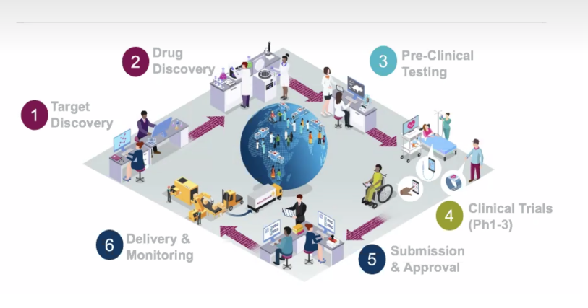
Scientific Compute Platform
Scientific Compute Platform (SCP)
The Scientific Computing Platform (SCP) is AstraZeneca’s approach to create a flexible & global high-performance computing environment supporting research across BioPharm, Oncology and Operations.
Growth Through Innovation initiatives are leveraging SCP capabilities to drive science and innovation e.g. CryoEM, Multi-OMICs, Imaging, BIKG, Augmented Drug Design.
The SCP platform comprises of three key capabilities:
Compute & Storage: Solve ever larger problems. Access to large scale compute environments integrated with storage platforms supporting handling large data sets.
Applications: Leverage well tested and performance optimized applications. Access to large portfolio of applications for data and scientific analytics supporting disciplines across AstraZeneca, e.g. Python, R, bioinformatics tools, AI & ML frameworks
Analytics environments: Specialist analytics environments support diverse scientific needs. Access to various analytics environment for data science, bioinformatics, chemistry and big compute for experts and beginners.
The SCP platform supports more than 2000 R&D scientists on a daily basis and provide services for more 250 analytics tools.
PLATFORM ROADMAP
NOW | NEXT | FUTURE
SCP US cluster build out to double the compute and storage capacity of SCP. Galaxy enables bioinformaticians to perform complex data processing and analysis with an easy to use tool. SCP EU cluster capacity uplift drives harmonisation by accommodating legacy Medimmune workloads onto SCP. Rstudio & Rstudio Connect provides core analysis environments upgraded and improve user experience. | SCP US cluster go-live, enabling more than 400 scientists to access HPC with low latency. New SCP control plane, redesign, architect the SCP control plane to allow multi region control from a single plane. Discovery studio, enabling UK structural biology groups to use SCP. | Enhanced support on storage and compute for structure chemistry on CryoEM. Migrate existing user and services, and onboard new users to SCP US Cluster. HPC as a Service that enables SCP to burst compute into public Cloud to provide more compute flexibility and capacity for R&D.
Notes:
Need alignment on budgets across all slides

Slide 11
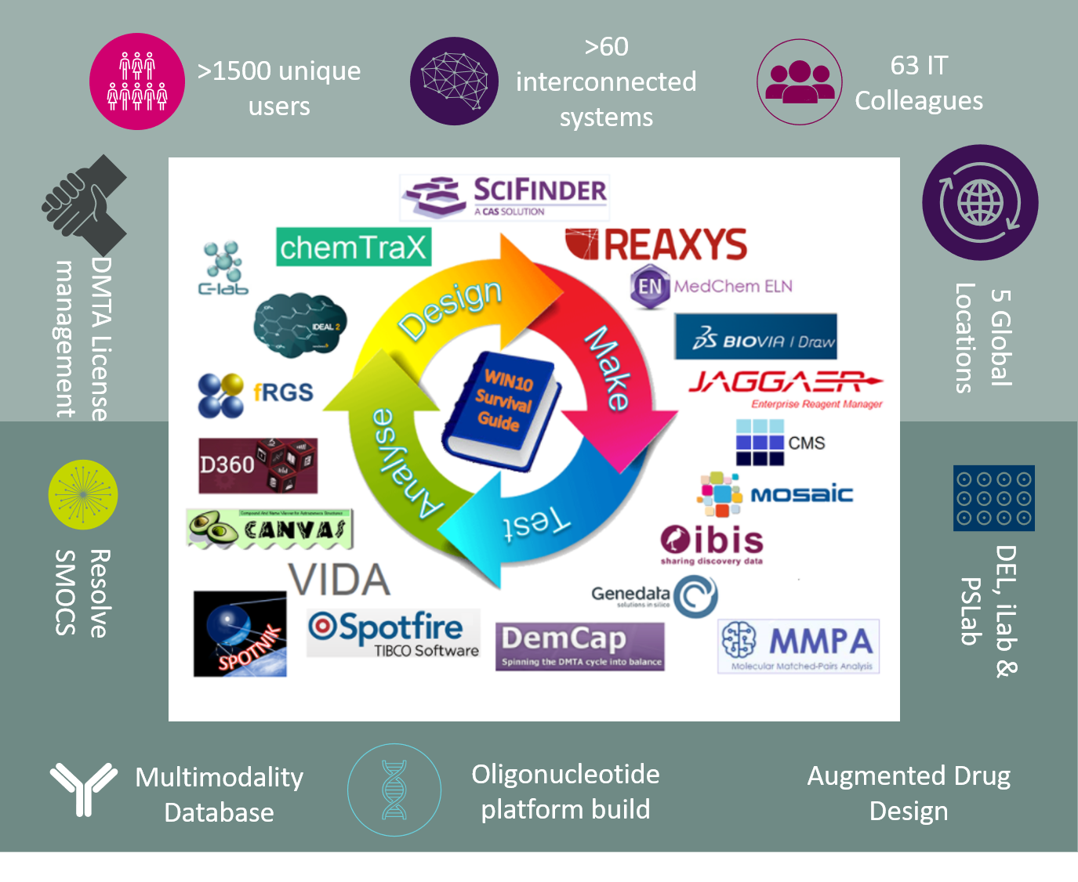
Augmented
DMTA
A-DMTA – Augmented Design, Make, Test & Analyse
Using data and advanced predictive models to reduce time to CDID by 1 year
Augmented Drug Design leverages a modern Data and AI cloud platform enabling in silico drug design with the potential to reduce typical drug discovery cycle time by 12 months. The platform will enable chemists and biochemists to find, access, deploy models and analyse chemistry data to design better molecules more effectively, and to make & test them faster on a scalable platform. New AI-driven capabilities are coupled with many existing DMTA tools expanding the science base able to access novel modelling techniques to improve drug discovery. The team also support and maintain Drug Discovery IT programs and toolsets (e.g D360, Mosaic, Genedata). Delivery Examples:
REINVENT – AI generated molecular ideation for hit and lead series
FEP+ Active Learning – AI scaled; physics based binding affinity predictions
Computer Aided Zynthesis prediction (CAZP) - Synthesis prediction and route planning
Predictive Insight Platform – ultra-scaled model inference platform, 100+ models
Chemistry Application Gateway (CAG) – API mesh to access all Chemistry data in AZ
DNA Encoded Library – screening platform capability
iLab, Oligonucleotide/Multi-modality registration & PharmSci Digital capability enablement
PLATFORM ROADMAP
NOW | NEXT | FUTURE
Add important new features to synthesis prediction (CAZP) software with important features and expand user base Expand Global Analytical Database (GAD) with more instruments Expansion of chemistry data sources & underlying services (CAG) REINVENT – new capabilities for Hit finding IBIS Test Services POC – increase flexibility for data PIP – add models for new modality property prediction (oligos) DEL Platform automated data pipelines released | Improve GAD performance Deploy MGears – Analytical software for CAG GUI for chemistry search across billion of molecules End-to-end model deployment and monitoring in PIP Initiate Augmented Intelligent Design Environment (AIDE) external RFP & internal MVP planning Support & enable Alexion DMTA systems onboarding Scale IBIS Test Services POC and fuse with Assay Catalogue project (Test modernisation) Architecture and process alignment for all-modality registration and search | AiZynth and Route Manager combined to form one product Augmented Design GUI Environment built / deployed for small molecule drug discovery and AI-generated recommendations - Continue to reduce time to CDID by using new ADD capabilities across all projects Leverage A-DMTA platform for MLAB (Machine Learning driven Antbodies & Biologics) platform capabilities iLab enabled with appropriate data sources and flows to support automated DMTA; iLab data feeding into wider chemistry models
Updated: May 9th 2022
Notes:
Need alignment on budgets across all slides

Slide 12
Imaging
Imaging
To ensure we maximise the value of our imaging data assets, the R&D Imaging ​Platform provides ​enriched analytics ready ​data when and where it is needed. By making imaging data Findable, Accessible, Interoperable and Reusable (FAIR), the Imaging Platform enables researchers to make new ​correlations, better characterise disease, improve patient stratification, monitor therapeutic response and ultimately accelerate the drug development process.​
The Imaging Platform delivers these benefits through a series of services and capabilities such as:
Gateways (data ingestion and export services)
Image processing pipelines
Hybrid (on prem and cloud) storage services
Image search and access APIs
Analysis tool support and maintenance
Image informatics professional services
PLATFORM ROADMAP
NOW | NEXT | FUTURE
ACTIVE KEY DELIVERABLES (BUSINESS FACING) Image ingestion, search, and access APIs Cloud based Halo AI image analysis environment HTS image ingestion and data/metadata management services Cloud optimized data processing pipelines Support of current data requests and platform operations | WHATS STARTING FOR Q4 (BUSINESS FACING) Integration of image metadata search with SDF DF+I (Athena Connector) GxP validated image labelling tool GxP validated image gateway and storage solution MvP Radiomics Image viewer and analysis tool (RadiAnt) Support of current data requests and platform operations | MAJOR DELIVERABLES IN 2022 (BUSINESS FACING) Production Radiomics Viewer/Labelling/Annotation/AI Model Hosting CIW support for new SCP architecture Additional shared Halo AI capability Support of current data requests and platform operations
Notes:
Need alignment on budgets across all slides

Slide 13
Omics
Omics
The omics platform aims to build omics expertise in a cross-functional team, to enable development and maintenance of technologies across the omics space. The omics platform aims to provide: (1)a robust, scalable, secure, compliant platform for storage of, processing of and access to data and metadata (2) Access to multi-omics data and processing through multiple bench science and data science interfaces​
Deliver Growth and TA Leadership:​
Support the delivery of improved disease understanding ​
Enable analysis of omics data from exploratory clinical endpoints to inform clinical trial design​
​
Accelerate Innovative Science:​
Enable analysis of pre-clinical omics data for target identification, target validation, biomarker identification and mechanism of action incl. drug resistance mechanisms​
Reusable data – reduce time spent searching for data from weeks to hours​
​
Be a Great Place to Work:​
Process optimisation – workflow optimisation, enhanced user experience
PLATFORM ROADMAP
NOW | NEXT | FUTURE
OncTM – Incorporate single cell analysis tools and platforms to support benchmarking vendors in MRD analysis CRISPR – scRNA-CRISPR (Perturb-seq) capability deployed and applied in 1+ drug projects MassSpec – Insight generation from px, Mx, Lx data through>3 examples from Data Search | CRISPR hit data in 5+ TTD, 2+ ICC, 9+ TDE projects CRISPR QC Monitoring Dashboard - AZ internal and external CRISPR data queryable in an easily accessible web user interface | FAIR NGS Data – ensure all NGS data is findable and reusable for advanced analytics. FAIR Mass Spec Data – Establish appropriate data format and metadata requirements to enable global searchability for MS-based omics (e.g., Px, Px w/ PTMs, Mx)​ Increase analytics and visualization capability for statistical analysis (e.g., ROSALIND, Genedata)​ Accelerate Functional Genomics Centre (FGC) - continue delivering against the central FGC computational strategy of scalable end-to-end informatics & FAIR data strategy​.
Notes:
Need alignment on budgets across all slides

Slide 14

BIKG
BIKG (Biological Insights Knowledge Graph)
BIKG's ultimate aim is to improve target and drug discovery pipeline decisions. BIKG builds a data pipeline which unifies scientific data in a knowledge graph structure and uses it to train machine learning models that produce better decisions.
Graphs and network biology approaches have been used with success in several settings in drug discovery. Modern graph ML methods have shown advantages over traditional (e.g. signature-matching) methods. BIKG data, tools and models make it easier for AZ scientist to leverage connected knowledge and modern graph ML models for their specific scientific question.
BIKG comes in different formats.
Browser: a web app to find all direct connections between a set of entities
Python packages: easily use BIKG data in your data science and ML scripts
Examples notebooks: a showcase how to apply BIKG to biomedical problems
APIs: use the APIs to build your own applications or get subsets of the data
Benefits: driving TSID decisions quantitatively to reduce attrition rate, recommending life cycle management indications with expected benefits >100m for each reposition; reducing literature and manual validation from months to minutes.
It mitigates the risk: of choosing the wrong target, picking ineffective indications, chasing the incorrect mechanism.
PLATFORM ROADMAP
https://bikg.astrazeneca.net/
NOW | NEXT | FUTURE
Monthly new data releases Building a Triage App PoC Launching a subgraph builder app Collaborating on rare disease use cases with Alexion Collaborating on a TReg use case with R&D Supporting our self-service recommendation system for CRISPR screens Research collaborations with Rakuten and Zitnik lab (Harvard) Working with NLP team on a new approach to extracting information from text | Fast querying and analysis of BIKG via databases Add internal AZ data in the graph, such as electronic lab notebooks (ELN) Ability for users to quickly add their own data to the graph Target ID for rare diseases with Alexion Informing CRISPR screens with target predictions for Treg-based cell therapy Researching into explainable AI (XAI) on graphs Dynamically generate graph-based features tailored to specific subgraphs | A user friendly ‘Insights Platform’ to enable scientists to interact with BIKG data and ML models using a website Enable re-usage - BIKG becomes an easily extendable and customisable graph for any biological use case Explainable AI methods for drug discovery are available Support a wide range drug discovery use cases across AZ
Updated: May 9th, 2022
Notes:
Need alignment on budgets across all slides

Slide 15
Digital Lab Platform
DIGITAL LAB
The Digital Lab Portfolio is a mixture of unique self-developed and Commercial Off the Shelf Software (COTS) solutions used by Scientists, for primary analysis, for lab workflows and driving lab operations.
Our vision, in collaboration with early R&D scientists, is to create an IT environment that digitizes the experimental process and makes data more available and re-usable.
PLATFORM ROADMAP
Create a
NOW | NEXT | FUTURE
Continued roll-out of AskLab to Gothenburg - A collaboration between R&D IT & Site Operations to simplify access to services for R&D Lab Scientists Securing access for external to our AZ instrumentation allowing secure, traceable collaboration on Scientific research projects Delivering enhancements to key lab applications (PCL,…) to make them available to wider teams of Scientists across Business areas and lab sites Generate insight about equipment maintenance and space usage to bring about benefit in estate management | Lab Data Strategy - Defining how lab data is used an managed aligning to FAIR principles and will give our Scientists clear processes to find their data Remediation of devices running Win 7 on the Corporate network so that they can continue to operate in a secure way Capital Demand Process - Providing platform resources to aid with the CAPEX process for complex asset onboarding. Streamlining CAPEX and SI introduction processes to ensure maximum efficiency | Self-Service & Scientist Collaboration Making it easier for Scientists to run independently from IT but with assurance of guardrails Virtualisation of lab workstations to give our Scientists more space in labs to work, increased scalable compute and decreased lifecycle mgmt. costs for R&D IT AR/VR – PoCs to establish the right use cases to scale and define a strategy to facilitate and accelerate the adoption of AR/VR in the lab space
Updated: May 9th, 2022

Slide 16
In Vivo Platform
IN VIVO PLATFORM
The completion of In Vivo work requires a great number of scientific groups and software solutions to manage the full animal lifecycle. The In Vivo Platform aims to deliver a cohesive software user experience that supports In Vivo work, end-to-end. To enable scientists to store and use In vivo data to facilitate new and novel outcomes and innovations.
Focus will initially be on data capture and management to allow Scientists to drive statistical study design and analysis. The platform will also deliver easier visualisations to get the best value out of In Vivo and help drive the 3R’s.
PLATFORM ROADMAP
NOW | NEXT | FUTURE
Tick@lab global delivery to enable global system for all animal management Study Log v4 US– New global build and US early adopter complete - supporting global adoption of in life study design, management and capture common tooling across all TAs Laboratory animal management dashboard Enabling global animal reporting with Tick@Lab to ensure regulatory compliance Grid safety study enhancements to enable large safety study loading inline with FAIR data principles | Partner modernisation replacement of current partner enabling accurate capture & reporting of external animal use Study Log - Global infrastructure & Early Adopter (UK and Sweden) supporting global adoption of in life common tooling across all TAs (study capture) Laboratory animal management dashboard Enabling global animal reporting with New Partner FAIR Data strategy workshops with Early Science preclinical capability and architecture | Study Log global adoption of in life study design Fair data strategy delivery (Tick@lab, Study Log, Grid, Provantis….) – bring data from key systems into an ‘In vivo Core’ for better analysis, and visualisation Animal management reporting initiatives – Support of regulatory reporting (RTO), operational measures and 3R’s (R&D objective)
Notes:
Partner = (Platform for Animal Research Tracking aNd External Relationships) Partner is used to facilitate the submission, review, and tracking of external study proposals/protocols and institute inspections. In addition, the site provides scientists with a mechanism for feeding back information on the performance of institutes (CRO, Collaborators & Suppliers) to ensure the highest ethical standards are upheld.' – 50% of AZ animal usage
Tick@lab = global animal management solution
StudyLog = Future Global study design and capture for In Vivo
In Vivo Core = Platform Fair data strategy – involving data, systems and strategic initiatives
Lam data Mart – animal reporting dashboard for animal number usage (internal and external)

Slide 17
Study Design and Intelligence
STUDY DESIGN AND INTELLIGENCE
A combination of custom developed applications and COTS capabilities that allows study designers to design clinical trials with well structured and predictive data with Merlin, and provides an overview of how we are running our clinical trials with historical, real-time, and predictive data that helps tell a story that can inform the decision-making process with Control Tower.
AstraZeneca has a large wealth of knowledge and experience for designing and monitoring Clinical Trials. Instead of purchasing many separate products that are disconnected and don’t provide all the needed functionality to serve our teams, we decided to build a group custom capabilities that uniquely serve us and provide a competitive advantage for the future.
PLATFORM ROADMAP
NOW | NEXT | FUTURE
One Merlin Similar Study Library and Early Feasibility MVP, and Patient Burden Index MVP make it easier to do initial Study discovery and determine the potential burden on a patient when costing a study | Delivery of the Visit Schema MVP for beginning the planning of a patients journey through a clinical trial. This helps to focus on the patient, reduce burden, and unnecessary costs in a trial. | Visit Schedule MVP for advanced planning through machine learning Site and Investigator Self-Service in One Merlin Cost Estimator integration with One Merlin for single experience and updated cost models
LSPC reports for Clinical Operations Control Tower for better visibility across Clinical Trials | Optimization of LSPC views based on feedback from LSPC members and filter optimization for faster narrowing to important information Data quality alerts for data owners to address | Focus on implementation of Phase 1 and Phase 2 Clinical Trials into Control Tower to give us a wider view on how Clinical Trial landscape
Portfolio Control Tower MVP with active pipeline/portfolio and trial volume, Key project milestones | Deliver Project Commentary so that project managers can provide feedback on their projects in the portfolio and a view on approval maps
Notes:
Need alignment on budgets across all slides

Slide 18
Operational Clinical Development Platform
OPERATIONAL CLINICAL DEVELOPMENT PLATFORM
Operational Clinical Development IT Platform aligned to Clinical Trials Value Stream enabling Core Transactional Digital Products leveraging set of COTS/Bespoke technologies. As a Core Products it enables key pillar of clinical trial execution excellence across Therapeutic Areas in R&D during study initiate, conduct, analysis & reporting and close-out activities associated to Perform Clinical Development Capabilities. It enables Clinical Operations, Study Data Management including Clinical Metadata Standards, Patient Randomization Data Capture, Biometrics (Analysis & Reporting) processes executed through out clinical study phases reducing overall trial cycle time.
Products included within the Platform:
Clinical Study Operations (aka VCV)
VCV Product is a SaaS Platform that enables E2E digital capability for initial set-up, conduct/monitor and closure activities of clinical trials from Study Management and Monitoring functions ultimately to reduce overall Site/Sponsor burden with decentralized virtual paperless trial management.
Randomization Trial Supply Management (aka CUBE RTSM)
CUBE Product is to efficiently and accurately control subject enrolment, randomization and automate supply, and resupply to depots and study sites.
Clinical Data Management (aka EDC)
Medidata Rave EDC is AZ utilized system of record for capturing, managing and reporting clinical patient data in Phase I–III studies, streamlining the clinical trial patient data capture process per clinical data standard specifications by Data Management.
Analysis & Reporting (A&R)
A&R Product consists of technology such as SAS Grid, Entimo Applications including bespoke components that enables activities associated with Clinical Data analysis and reporting by BioStat, Clinical Programming functions within TA to execute complex data transformation from SDTM to ADaM to TFLs outputs summarized for Clinical Summary Reports(CSR).
Clinical Data Standards (Pending Implementation as part of RCDF Program)
Product to provide robust clinical standards development platform allowing management of end-to-end data standards specifications (i.e.: CDASH > Raw>SDTM>ADaM>TLFs)
PLATFORM ROADMAP
NOW | NEXT | FUTURE
Electronic Health Record to EDC Pilot with Ignite Vendor as part of Future Trial Design feasibility. EDC Data Extract Implementation for Data Lake Ingestion as part of RCDF initiative. Medidata Cloud EDC Feasibility. External Sponsor Research Studies transition to VCV CTMS Module. Enhanced Data/App Integrations across Products to streamline E2E Clinical Data Flow. Enhancements to A&R Product to support BioStat and Programming Functions per Roadmap. RTSM Integration Uplift/Enhancement to Supply Chain Components such as Home Supply. | 2-3x Pilot studies with Veeva EDC to prove proof of technology. A&R DR Strategy, CARS Archival, SCE Extensions with R/Python/JMP/JReview, Integration Enhancements Site Payment Tech Selection and MVP Approach. Implementation of Ryze Clinical Standards Product and its MVP integration interface within ECS RCDF Workstream. Enable IT Product Capability for RTMS and Clinical Data Standards Product. | Veeva EDC Scale-up (Pending Funding/Go Decision) Clinical Data Standards Product Implementation to enable E2E Standard repository. Site Payments / Site Connect/ Cross Vault Connection Module in VCV. Future A&R Strategy.
Updated May 9th, 2022
Notes:
Refer to respective Product Roadmap for more details on Platform Roadmap.

Slide 19
Digital Patient Solutions
Digital Patient Solutions
Digital Patient Solutions platforms are a Software As A Service components that enables developing, launching and maintaining both consumer health and regulated digital products.
The enabling platforms include Boost and the SensorKit which offer a reliable, tried and tested software modules to build upon. These platforms support Unify, Turbo+, Care, Reflect and have a growing number of products in the pipeline.
DPS maintains shared services needed by most products, such as authentication, scheduling, notifications, data persistency, mobiles applications and clinician dashboard are part of the capabilities of the platforms. These services enable product teams to build applications faster, reduce cost and increase overall quality.
NOW | NEXT | FUTURE
Current capabilities for DPS include: Data persistency Authentication & authorization Clinician dashboard Patient mobile apps eCOA & ePro Bluetooth connectivity to devices Current products in DPS portfolio include: Unify Care Turbo + Reflect (PoC) Eco-Digital (PoC) | Propel – A connected mobile hub that is integrated into multiple devices and peripherals. Enabling the business to interact remotely with patients and test new UX paradigms Software as a Medical Device - Release Boost and SensorKit as SaMD compatible modules ready to support Class II products Content Management System – Support authoring, managing, distributing and approving information used in our products. | AI Plug & Play- Allow the integration of AI module into the platform so they can developed into products. Analytics Dashboard – Understand user patient, HCP) behaviour as they use our products. Clinical Trial Management at Scale – Support 80% of all AZ studies across multiple TAs.
PLATFORM ROADMAP
Updated May 9th, 2022

Slide 20
Drug Development Data Platform (3DP)
DRUG DEVELOPMENT DATA PLATFORM
WHAT DOES IT DO?
A single, trusted, easy to access source of clinical, safety, regulatory and portfolio management data for reporting, AI and R&D applications.
WHY IS IT HERE?
The effort to find, access, integrate and assure R&D data is large, and duplicated inconsistently across teams. The platform automates the process end to end and provides a single place to consume from.
WHAT BENEFITS DOES IT DRIVE OR WHAT RISKS DOES IT MITIGATE
Greater speed to insight – as data is pre-prepared and ready to use.
Higher data quality and consistency – one trusted source used by all.
Reduced effort to acquire and utilise new data.
PLATFORM ROADMAP
NOW (2021 to date) | NEXT | FUTURE
Portfolio Tower. Automated data acquisition, integration and presentation of GPPM performance and insights. Study Cycle Time benchmarking. External study benchmarks vs like for like AZ actuals, supporting goal of top industry quartile cycle time. CRO operational data. Ingested from priority CROs allowing metrics to presented like for like vs internal studies. Replacement of IRT reports. Launch of 7 critical operational reports to Development Operations, allowing decommissioning of IRT. | Centralised Monitoring MVP. Replatforming, leveraging Single Source of Truth and Self-Serve Analytics, and gaining GxP validation. Trial Diversity and Inclusion metrics. Generate D&I index for clinical trials, to drive greater diversity in recruitment and trial design. Unify data available for data science. Ingestion of Unify patient reported outcomes and user data for AI-driven event identification. Patient Safety Reporting MVP. GxP validated analytics and reporting capability, initially for vaccine and then extending to wider portfolio. Study Patient. Integrating Patient Level Database (PLDB) for advanced data queries Enhanced User Search capability through DisQover. | Enabling patient-centric trials and remote data collection: Establish scalable mechanisms for patient data onboarding that create efficiencies and ease the engineering burden on the data science community. Build data products to enable rapid consumption of patient data across a broad range of use cases (e.g., DxTx, novel endpoint development and validation, etc.) Integrate patient data into systems and activities that support submission: e.g., Risk-Based Quality Management, Medical Data Review, and Data Mgt. Inclusion of studies approved for Extended Primary Use as part of the Patient Level Database
Notes:
Need alignment on budgets across all slides

Slide 21
Enterprise Platform One pagers
C

Slide 22
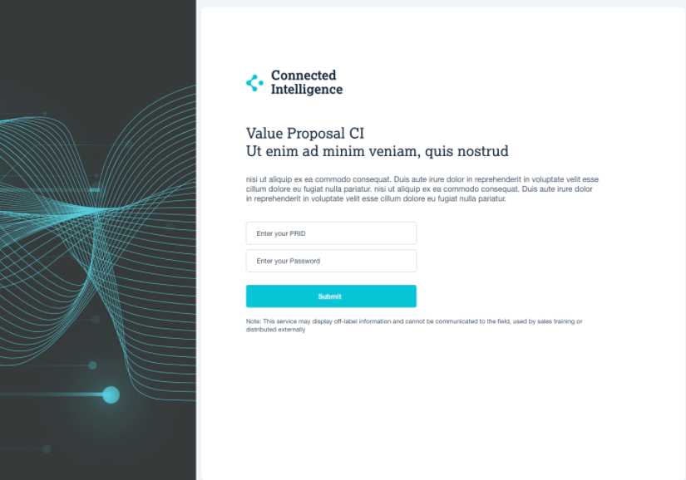
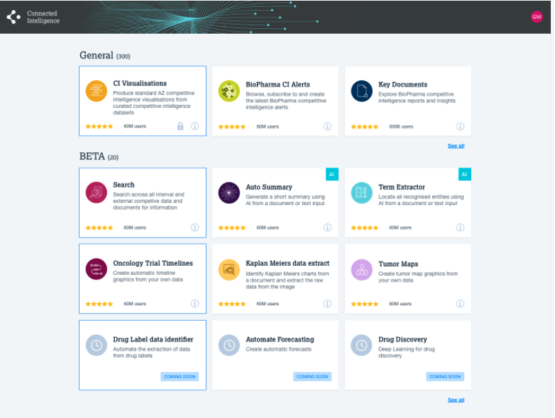
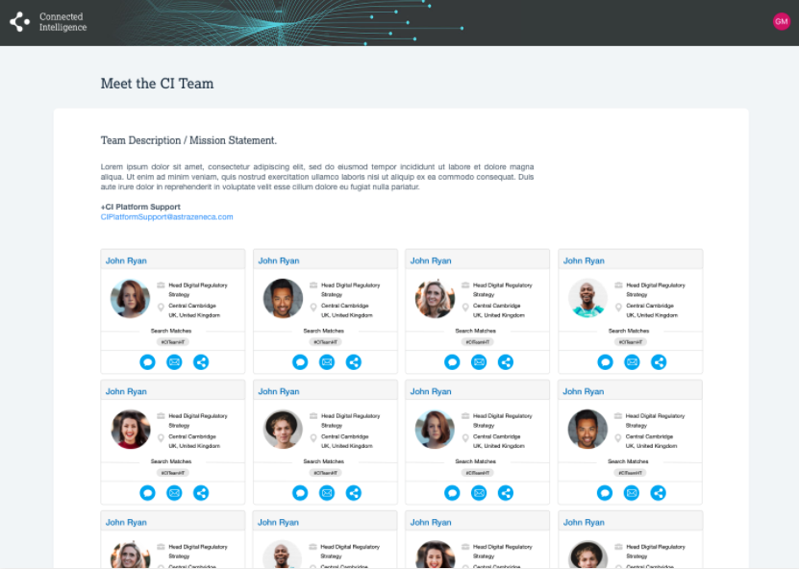
Connected Intelligence
Connected Intelligence PLATFORM
WHAT: App Store for FAIR AI & data app platform
Industrialised IT platform for FAIR AI/data assets
MVP’d with competitive intelligence apps disseminating in near-real-time, single source of truth of competitive intelligence from BioPharma and Oncology
WHY IS IT HERE:
Universal AZ access to FAIR competitive insight, single source of truth, immediately accessible (e.g. for SET), relieve manual tasks from CI professionals
Universal AZ access to FAIR AI & data assets to unblock and accelerate innovation (IT2025)
Data Find & Integrate: Advanced search & integration. For the first time scientists can perform complex searches for patient level data through Scientific Intelligence.
WHAT BENEFITS DOES IT DRIVE OR WHAT RISKS DOES IT MITIGATE:
Tangible value: $millions potential identified in cost/time savings productivity increases for initial apps and in removal of effort. Potential for carbon/electricity savings too. Goal is tangible value exceeds development spend.
Intangible value: accelerated innovation, universal AZ access to democratised FAIR assets, including single source of truth on competitive insight from initial apps
Risk mitigations (app platform): mitigates current risks of blocked innovation, duplicate project effort/cost, stranded AI assets, developer frustration and reduced productivity.
Risk mitigations (CI apps): mitigates current risks of conflicting/slow/under-informed strategic decisions due to inaccessible/delayed/under-developed competitive insight
Examples of Connected Intelligence interface designs/functionality for 2022
PLATFORM ROADMAP
NOW (Q3 2021) | NEXT (Q4 2021) | FUTURE (2022)
ACTIVE KEY DELIVERABLES (BUSINESS FACING) | WHATS STARTING FOR Q4 (BUSINESS FACING) | MAJOR DELIVERABLES IN 2022 (BUSINESS FACING)
BioPharma CI: Bug fixes and user requests for 6 apps Requirements capture and development of 3 more apps Oncology CI: 3 apps in prototyping Requirements capture for future apps App platform (asset publication/reuse): Requirements gathering, Tumour maps POC | BioPharma CI: Launch of Congress app Data Curation app Landscape Explorer app Oncology CI: Launch of Oncology Trials Search app Kaplan-Meier Digitization app Competitive Landscapes app App platform (asset publication/reuse): Requirements gathering inc Unified Memory | BioPharma CI: Apps enriched with automation, vendor input integration, advanced data products, increasing search sophistication Oncology CI: New apps: Congress data mining​, R&D Portfolio Linked database​, R&D Innovation recommender​, Trial Site Maps​, KOL Ranking​ App platform enables AZ-wide: Publish your own FAIR app/API/dataset/code
Notes:
Need alignment on budgets across all slides

Slide 23
AI Ops
AI OPS Platform
AI Bench
An end to end data science environment with all required tools for Productionising Data Science at Scale. Supports MLOPS, GXP, and AZ Acceptance to Service. Built on the AWS Cloud using the SageMaker Stack.
194+ customers across AZ. Reduced time to deliver Data Science Environments to the business from 3 Months to 1.5 days.
Dataiku
A drag and drop data science tool targeting on uplifting the “Citizen Data Scientist” with cutting edge machine learning technologies. Dramatically reduces the learning curve required to extract, transform, load and analyse data.
Recently raised funds across AZ to open up to customers outside of R&D. 100+ customers across R&D, Commercial, Finance, HR, Operations. Ongoing production workloads.
Central Model Registry
A central location for all AstraZeneca’s AI Models across the company enabling collaboration across teams, archival of results and parameters and reusability of the companies existing data assets. Launched with pilot customers.
PLATFORM ROADMAP
NOW | NEXT | FUTURE
Build out Kubeflow Machine Learning Platform that enables ML engineering teams in R&D Enhance AI Bench with SageMaker Studio capability that offers full end-to-end ML engineering capability. GXP Gap closure that enable CMO’s NLP A-Class project | GxP validated Central Model Registry public release enables model registry, tracking and sharing for GxP validated ML workflows AI Bench with SageMaker Studio non-GxP release that enables ML engineering workload | Automation of GXP qualification process to increase the frequency of GXP release GxP qualified Kubeflow Machine Learning platform for ML engineering teams in R&D. Feature Store for feature engineering, tracking and sharing across R&D teams Model serving and hosting platform to deploying ML models at scale.
Notes:
Need alignment on budgets across all slides

Slide 24
R&D Data Foundation
R&D Data Foundation
The R&D Data Foundation exists to make AZ’s R&D data Findable, Accessible, Interoperable & Re-usable. It consists of a number of products:
R&D Data Lake: A location to publish data to & consume data from. GxP Data Lake prepared for Extended Primary Use and on-going study use.
R&D Data Catalogue: R&D’s data market place. Digitised request services for ingestion, curation and discovery. Publishes and integrates with a business glossary to harmonise terminology and improve search.
Reference & Master Data Management: This service will allow AZ to vastly improve the quality of data that scientists are working with.
Track, Trace & Audit: Making sure governance is working. TTA will help scale R&D’s audit capability and help protect AZ from significant compliance risk.
Capabilities built on these foundations will enable the whole R&D pipeline
PLATFORM ROADMAP
NOW | NEXT | FUTURE
GxP analysis writeback to data lake for submissions Semi-automated cataloguing Mastering HCO and HCP information integrated with VCV and Data Lake Indexing of Clinical Data to enable easy searches across studies approved for internal re-use Development of a Patient Level Data Product for studies approved for internal re-use that integrates with relevant data sources to enable cohort selection Track AI Bench access to data in the lake Write back to Entimice for N&A Ph2 and analysis data | First data governance workflows automated by business process engine Track Imaging and Omics Data access and track training compliance of users Write back to Entimice for AIDA and DPCD via the lake, as a common pattern. | Externally shared data asset management including public data sets Capability to provide detailed and granular data type specific meta data to enable more advanced searches Alerts on non-compliance of data access

Slide 25
Old platforms
D
Legacy views

Slide 26
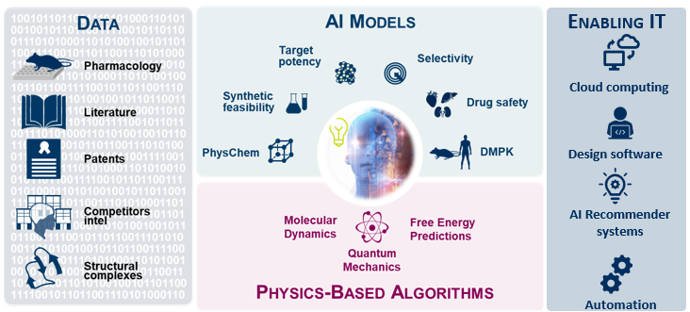
Augmented
Drug Design
ADD – Augmented Drug Design
Generate insights from data and advanced predictive models to reduce time to CDID by 1 year and create First-and Best-in-class drug candidates
New Chemistry Data and AI cloud platform enabling in silico drug design with the potential to reduce typical drug discovery cycle time by 12 months. ADD will generate a modern data and AI platform upon which chemists and biochemists can find, access, use and analyse chemistry data to design better molecules more effectively, and to make & test them faster. AI/ML modelling capability will enable all drug discovery projects, with a common set of tools, models and the latest technologies on a scalable, automated platform. Delivery Examples:
REINVENT – Ai generated molecular ideation
FEP+ Active Learning – AI scaled; physics based binding affinity predictions
AIZynth + reaction connect – Synthesis prediction and route planning
Predictive Insight Platform – ultra-scaled model inference platform, 75+ models
Chemistry Application Gateway – API mesh to access all Chemistry data in AZ
PLATFORM ROADMAP
NOW | NEXT | FUTURE
PIP & D360 integration and rollout to 1000 users REINVENT integrated with PIP and cloud docking AiZynth MIT Q2 Update with latest features MELLODDY Year 2 runs complete, model hosted in PIP with 5000 predictive endpoints AIDE: MOE COTS solution business evaluation complete PIP: Average model deployment time goal met PIP: human PK models deployed Enhanced REINVENT UI released to increase utilisation for AI de-novo design ideas | Enable 2/3rd small molecules drug discovery projects to utilise ADD Data and AI capabilities, to accelerate 3(L)-4(M)-5(H) milestones Reaction Connect: integrated into internal ML workflows PIP: in-vivo dog PK models deployed REINVENT and absolute binding FEP workflows combined Reaction Connect data AI ready Resolve - New LIMS for protein structure including CryoEM support GAD: Demonstrated effort reduction and user uptake | AiZynth and Route Manager combined to form Synthesis workbench Search UI productionised with search across all ADD data, billions of molecules and data points ADD Data Engineering platform used for all cheminformatics data pipelines (replacing Oracle scripts + Pipeline Pilot) Integrated ADD UI framework for drug design REINVENT + IDEAL + Canvas + Spotfire + PIP/CAG UI ++ (in lieu of AIDE vendor agreement) Continue to reduce time to CDID by using new ADD capabilities across all projects
Notes:
Need alignment on budgets across all slides

Slide 27
(D)MTA PLATFORM
MTA PLATFORM
The Make-Test-Analyse (MTA) platform builds and runs COTS and in-house solutions enabling chemists and biologists to run DMTA (Design, Make, Test, Analyse) cycles as they refine leads on the journey to providing candidate drugs
This platform enables and supports scientists from Discovery Sciences, Oncology, R & I and CVRM therapy areas developing small molecule and new modality (e.g. peptides. oligonucleotides, protacs) candidates handling around 3000+ scientists globally with 25-30 critical applications catering to candidate drug discovery
PLATFORM ROADMAP
NOW | NEXT | FUTURE
D360 integration with Predictive Insight Platform to enable faster and more robust deployment of insightful AI models which will drive search of new drugs faster and more accurately Qlik replication being used globally by 4K scientists allowing a more reliable replication of compounds and samples and tracking. Consolidation of Mosaic systems across MTA, ADPE and BPD for a better user and customer experience | New Molecule Registration System initial deployment - Central repository capable of capturing the defining attributes of synthetically-modified oligonucleotides and peptides supporting new therapeutic drug discovery 5 Days SAR dashboard delivering insight on operations within Compound Synthesis & Management informing decision-making to maximise process efficiency and reduce waste | Driving the move to a holistic compound management tracking system as Scientists move to CBC Furthering capabilities within Biologics and new modalities to help shorten lead time generation across therapeutic areas Development of Global Analytics database which will enable Advanced Chemistry Development for small molecule chemistry

